Slide 1
Chapter Two
Queuing System and Discrete- Event Simulation

Slide 2
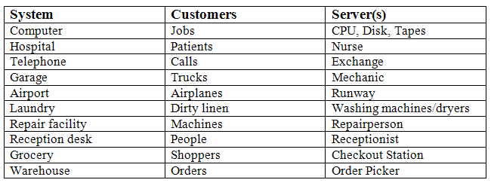
Characteristics of Queuing Systems
The key elements, of a queuing system are the customers and servers.
Customer: refers to anything that arrives at a facility and requires service e.g., people, machines, trucks, emails, packets, frames, patients.
Server: refers to any resource (Person, machine)that provides the requested service, e.g., repairpersons, washing machines, runways at airport, host, switch, router, disk drive, CPUs in computer.

Slide 3
The Elements of a Queuing System
The Calling Population: The population of potential customers, referred to as the calling population.
System Capacity: The maximum number of customers allowed in the system or waiting line.
The system capacity has no limit, meaning that any number of units can wait in line. Finally, units are served in the order of their arrival by a single server or channel.
When a system has limited capacity, a distinction is made between the arrival rate (i.e., the number of arrivals per time unit) and the effective arrival rate (i.e., the number who arrive and enter the system per time unit).
iii. The Arrival Process:- Arrivals may occur at scheduled times or at random times. when at random times, the inter-arrival times are usually characterized by a probability distribution.
Inter arrival time is the time between each arrival into the system and the next.

Slide 4
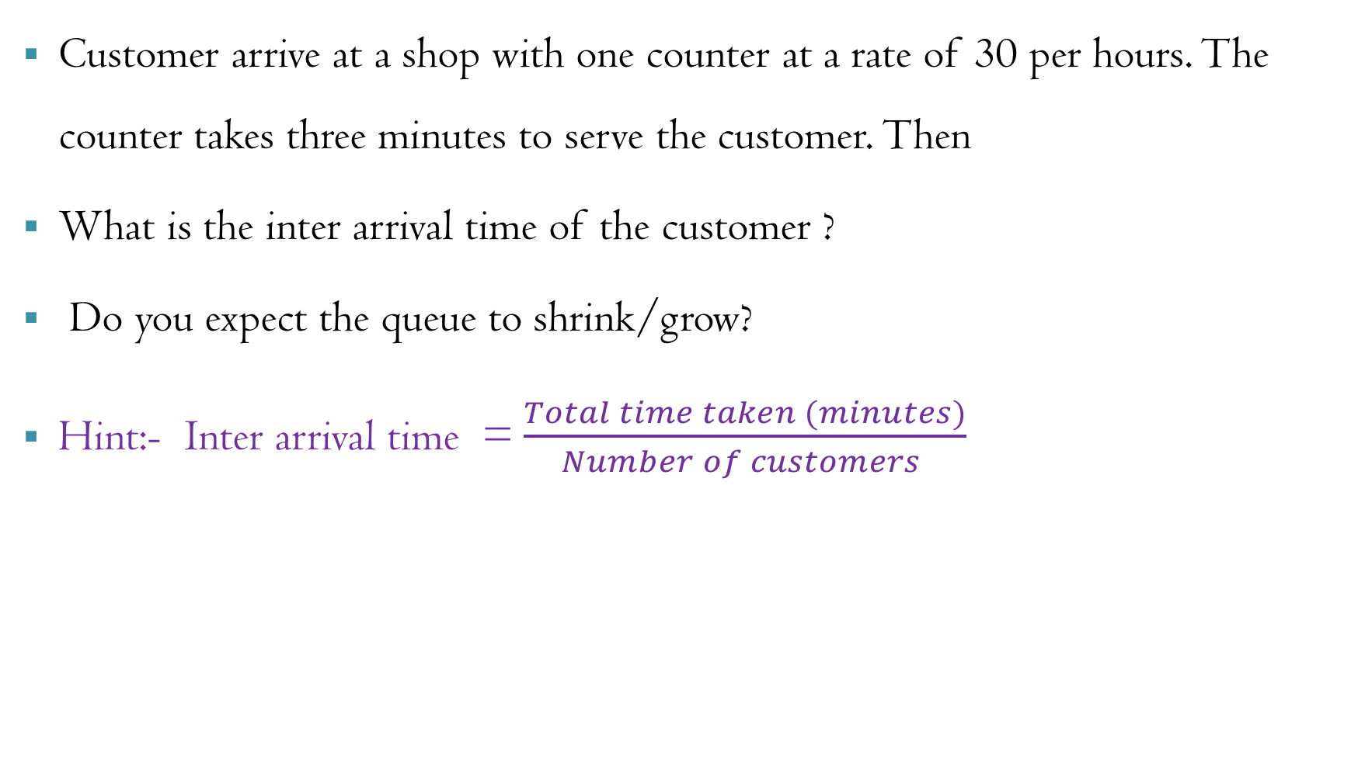
EXERCISE
Customer arrive at a shop with one counter at a rate of 30 per hours. The counter takes three minutes to serve the customer. Then
What is the inter arrival time of the customer ?
Do you expect the queue to shrink/grow?
Hint:- Inter arrival time = $\frac{Total time taken (minutes)}{Number of customers }$

Slide 5
Single channel Queuing System
Single-station or single-channel queuing system is the name applied on those problems in which only one unit (station) is delivering the service.
For any single channel queuing system, if the inter arrival less than the service time, then the waiting line will grow without bound. When queues grow without bound, they are termed “explosive” or unstable.
In a single –channel queuing system there are only two possible events that can affect the state of the system.
The entry of a unit into the system.
The completion of service on a unit.

Slide 6
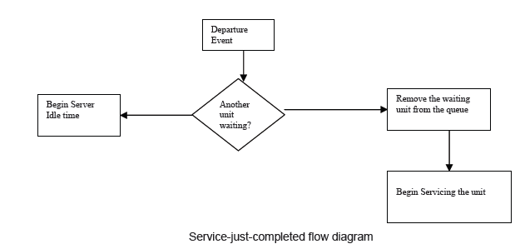
Cont…
Departure event occurs when a unit has just completed the service, the simulation proceeds in the manner shown in the flow diagram below.
Note that the server has only two possible states: it is either busy or idle.

Slide 7
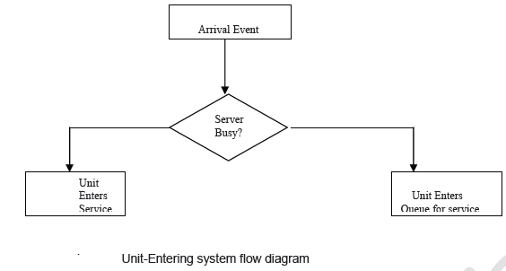
Cont….
Arrival event occurs when a unit enters into the system. The flow diagram for the arrival event is shown in figure below.
The unit may find the server either idle or busy, therefore, either the unit begins service immediately, or it enters the queue for the server.

Slide 8
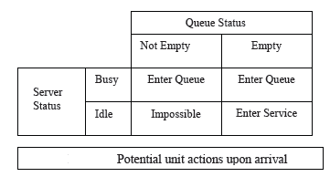
Cont…
If the server is busy, the unit enters the queue. If the server is idle and the queue is empty, the unit begins service. It is not possible for the server to be idle and the queue to be non empty.

Slide 9
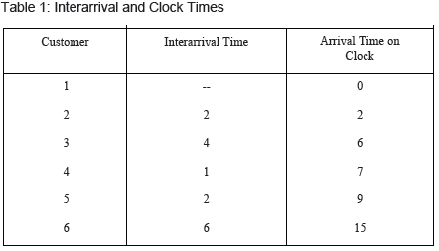
Cont…
In a single-channel queuing system, interarrival time and service time are generated from the distributions of random variables.
The table given below contains a set of five interarrival time to compute the arrival time of six customers at the queuing system.
customer |  | Service time
1 |  | 2
2 |  | 1
3 |  | 3
4 |  | 2
5 |  | 1
6 |  | 4

Slide 10
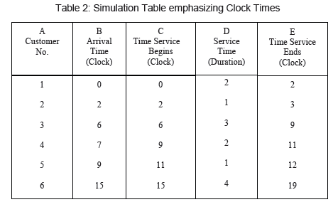
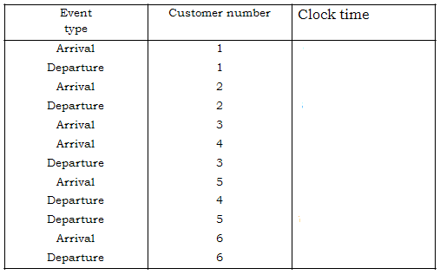
Cont…

Slide 11
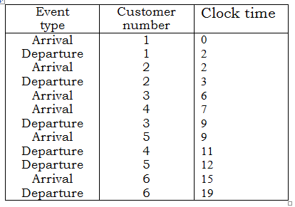

Slide 12
SINGLE CHANNEL Queuing PROBELEM EXAMPLE
A small grocery store has only one checkout counter. Customers arrive at this checkout counter at random from 1 to 8 minutes apart. Each possible value of inter arrival time has the same probability of occurrance. The service times vary from 1 to 6 minutes with the probabilities shown in third table . The problem is to analyze the system by simulating the arrival and service of 20 customers. So, we need to do the following tasks.
Generate inter arrival time distribution?
Generate service time distribution?
Inter arrival time determination?
Service time determination ?
Generation of simulation table?
Doing calculation after generating simulation table ?
RD for IAT | -- | 913 | 727 | 015 | 948 | 309 | 922 | 753 | 235 | 302 | 109 | 093 | 607 | 738 | 359 | 888 | 106 | 212 | 493 | 535
RD for ST | 84 | 10 | 74 | 53 | 17 | 79 | 91 | 67 | 89 | 38 | 32 | 94 | 79 | 05 | 79 | 84 | 52 | 55 | 30 | 50

Slide 13
Arrival Time distribution Table
Inter Arrival Time (min) | Probability | Cumulative Probability | Random Number Assignment
1 | 0.125 | 0.125 | 001-125
2 | 0.125 | 0.250 | 126-250
3 | 0.125 | 0.375 | 256-375
4 | 0.125 | 0.500 | 376-500
5 | 0.125 | 0.625 | 501-625
6 | 0.125 | 0.750 | 626-750
7 | 0.125 | 0.875 | 751-875
8 | 0.125 | 1.000 | 875- 000

Slide 14
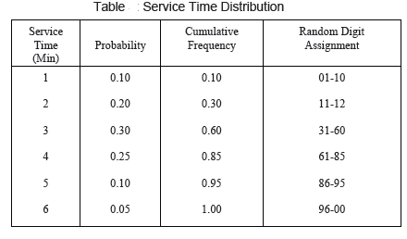
Service Time distribution Table

Slide 15
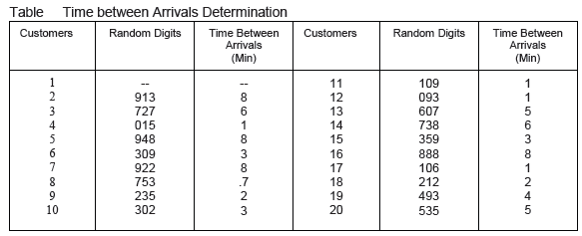
Time Between Arrival Determination

Slide 16
Time Between Arrival Determination

Slide 17
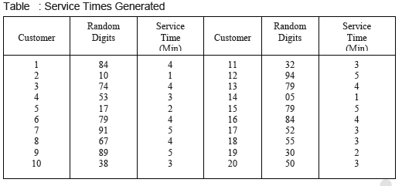
Service Time Determination

Slide 18
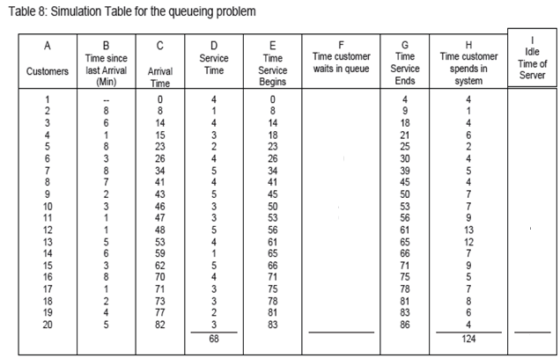

Slide 19
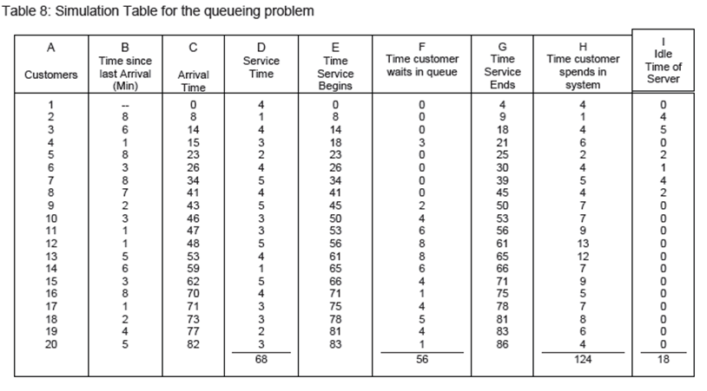

Slide 20
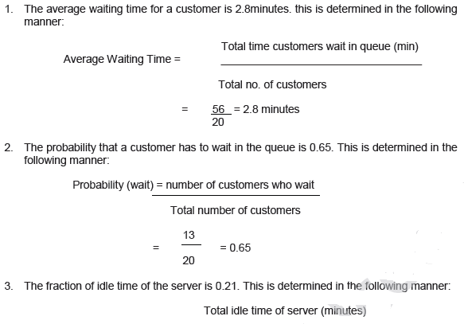

Slide 21
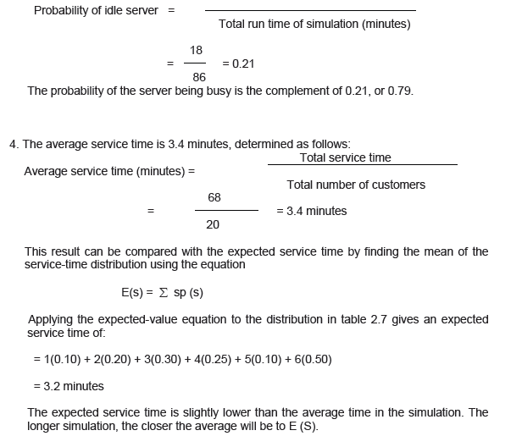

Slide 22
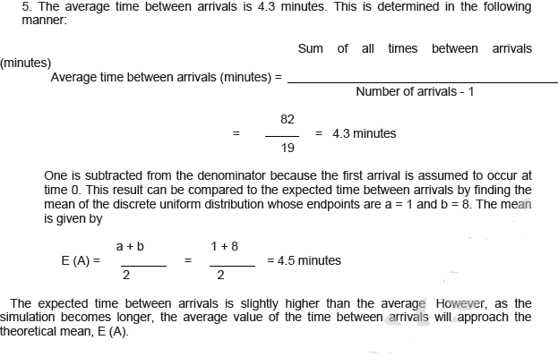

Slide 23
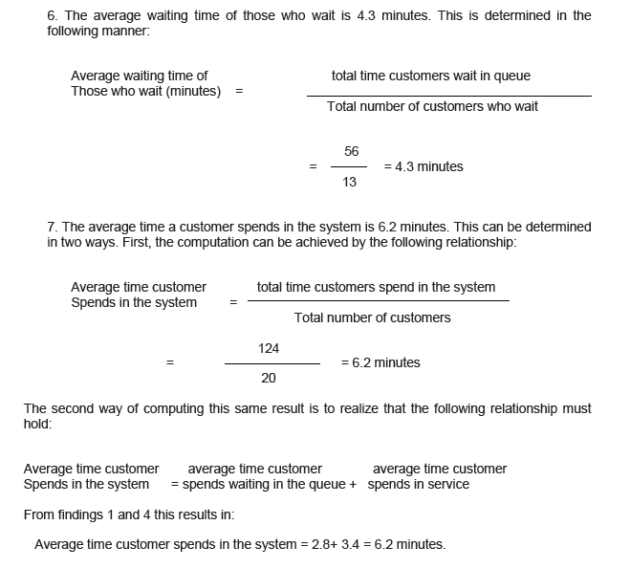

Slide 24
Thank You
??

